Slide 1
Chapter-3
Second Order Linear Equations

Slide 3
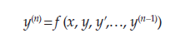
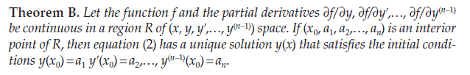
Existence and Uniqueness of Solutions

Slide 5
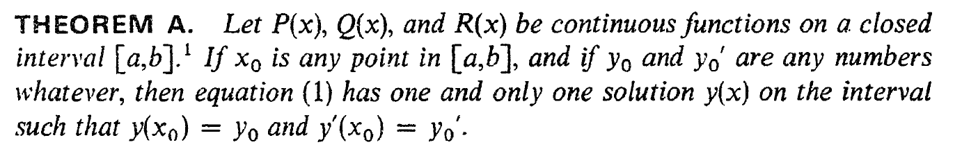
Section - 14

Slide 7
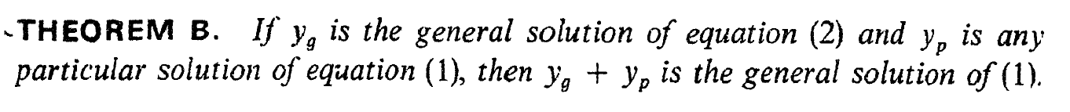
Section - 14

Slide 8
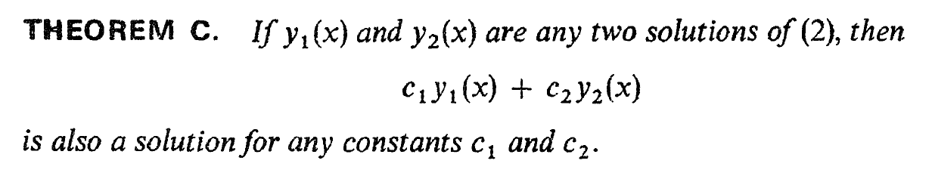

Slide 9
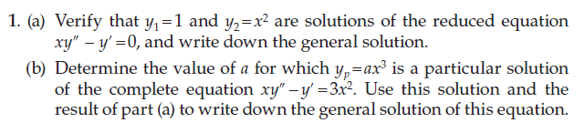
Section 14

Slide 11
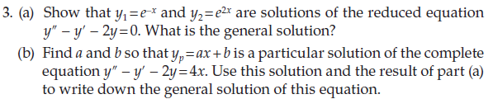

Slide 12
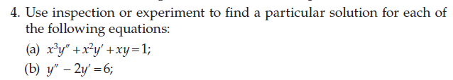
Section 14

Slide 13
Lecture on 21/9/22

Slide 15
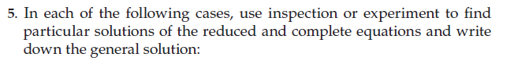
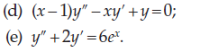

Slide 16
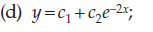
Section 14

Slide 17
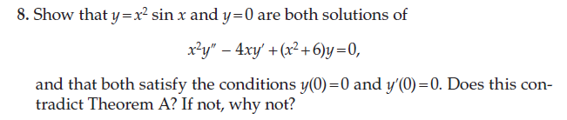

Slide 18
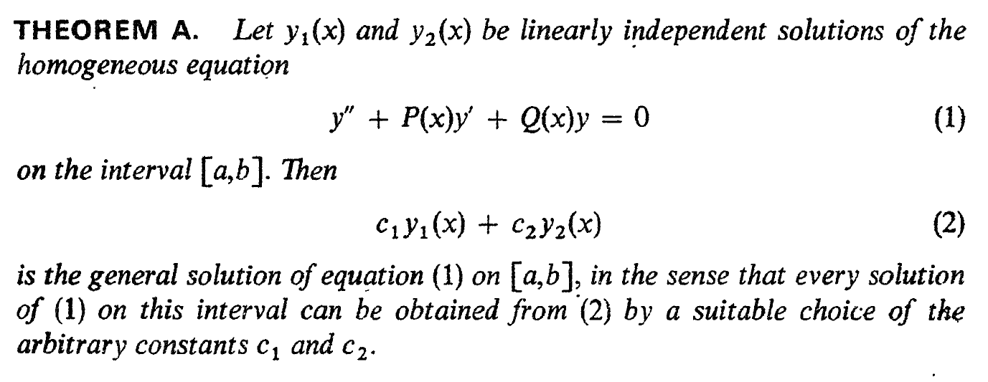
Section 15 - The General solution of the Homogeneous Equation

Slide 20
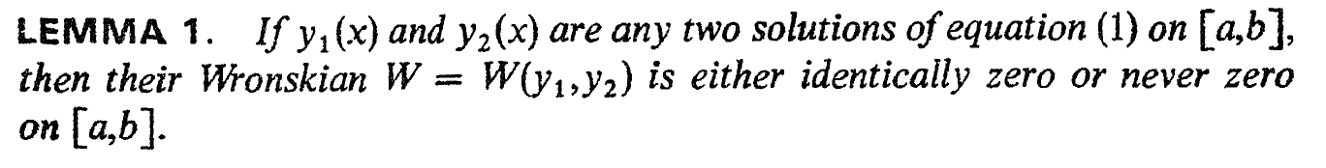
Section 15 - The General solution of the Homogeneous Equation

Slide 21
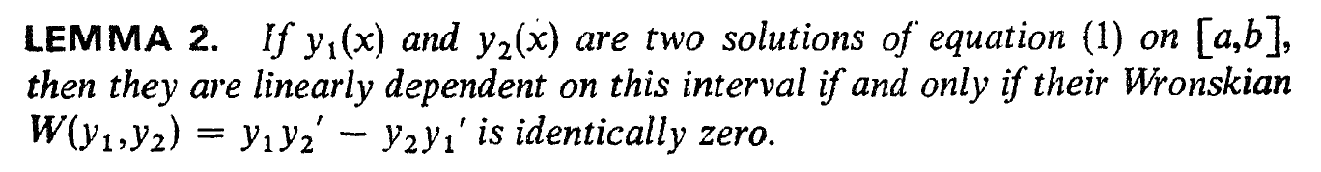

Slide 22
Lecture on 23/9/22

Slide 25
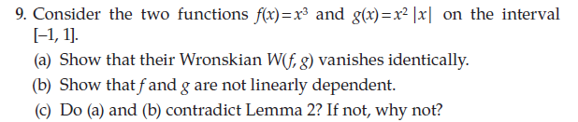

Slide 26
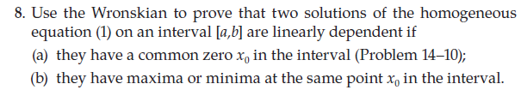

Slide 27
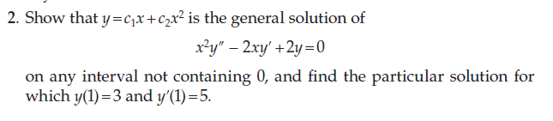

Slide 28
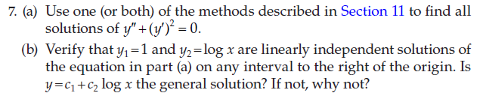
Section - 15

Slide 29
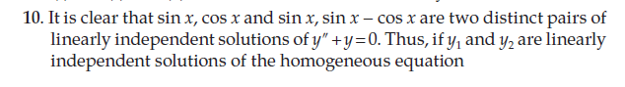
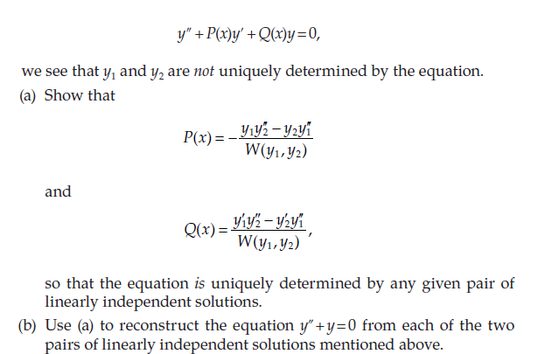

Slide 30
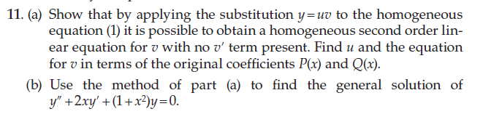
Section - 15

Slide 32
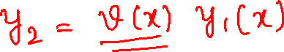
Section-16
The use of a known solution to find another

Slide 33
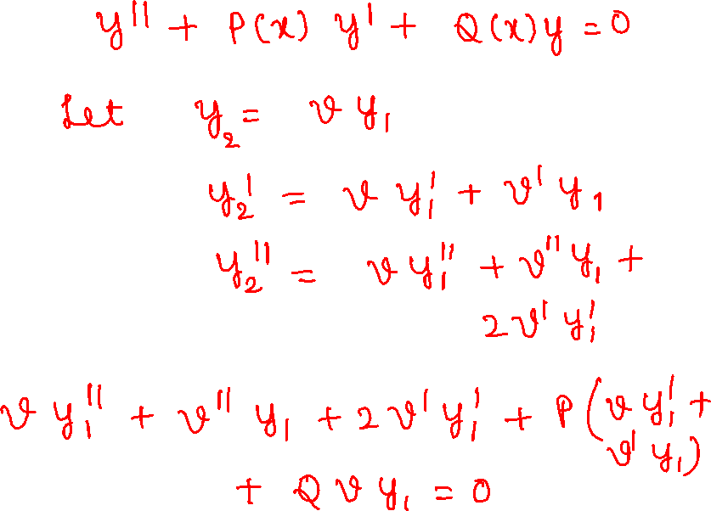

Slide 34
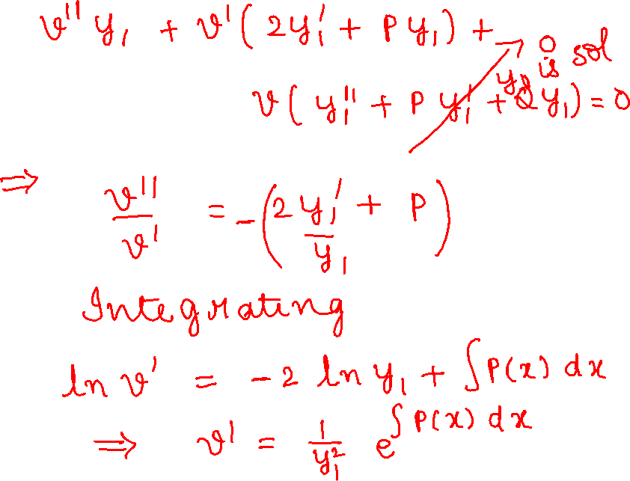

Slide 35
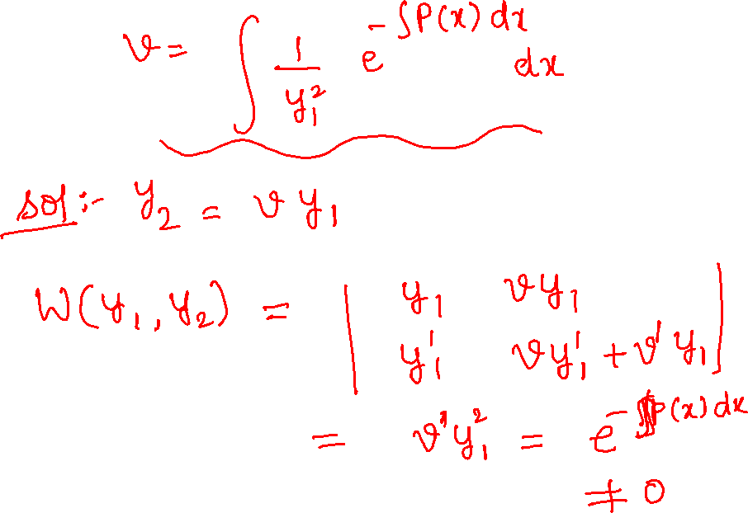

Slide 36
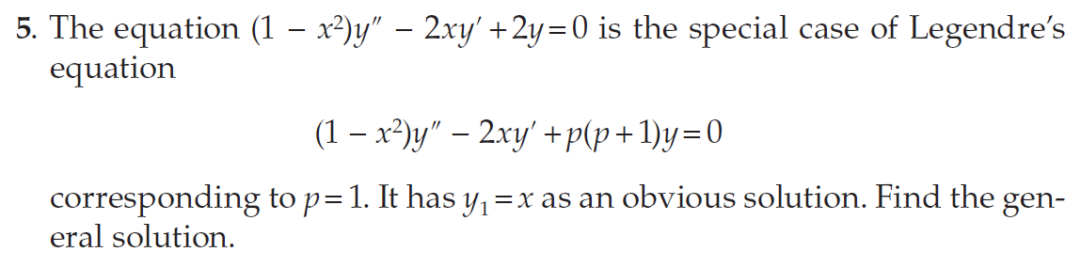
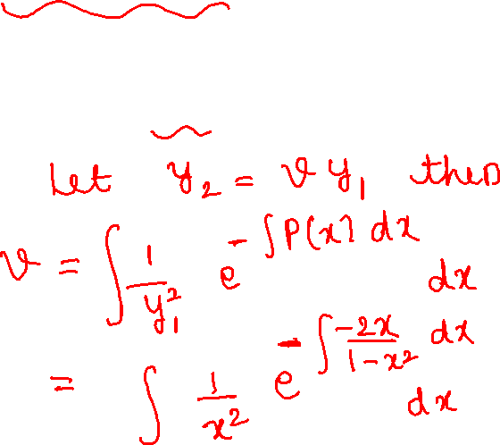

Slide 37
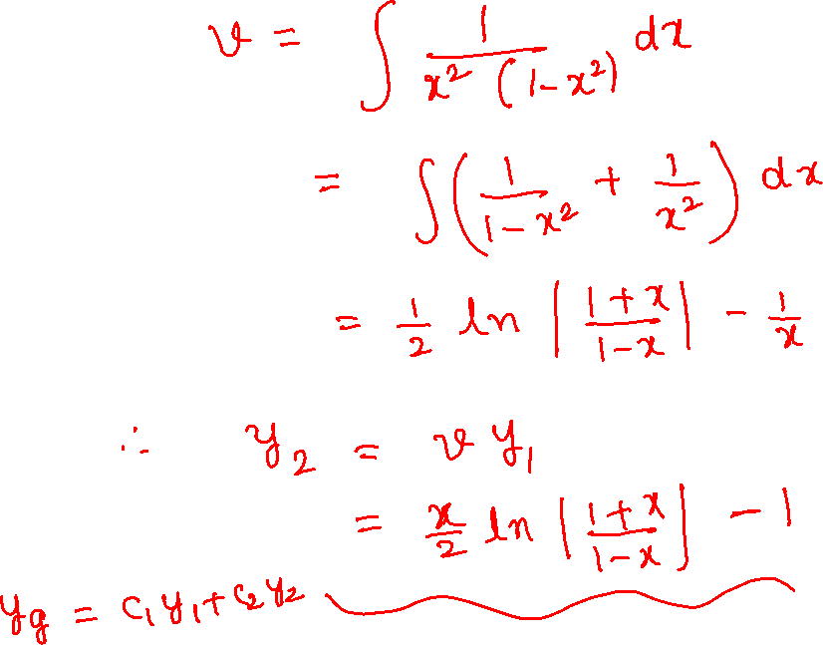

Slide 38
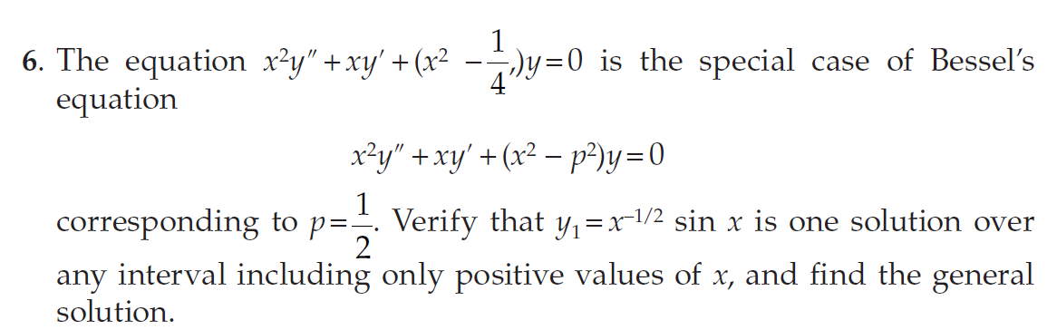
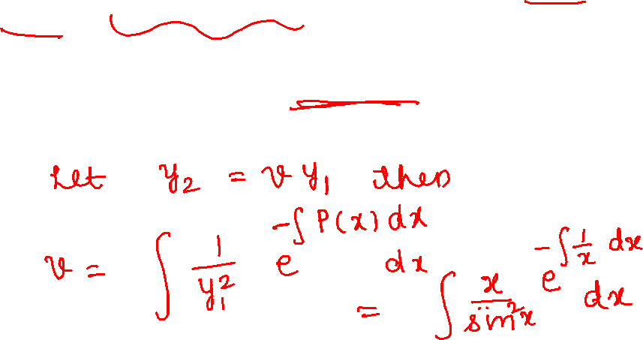
Section - 16

Slide 39
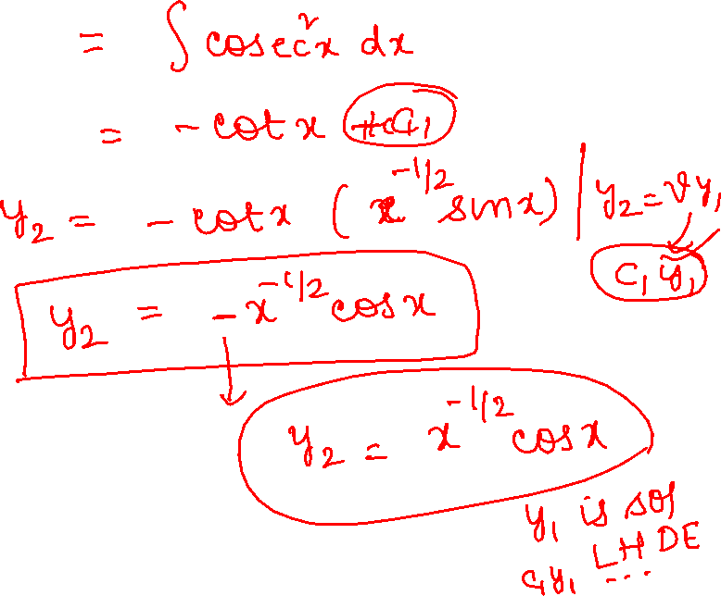

Slide 40
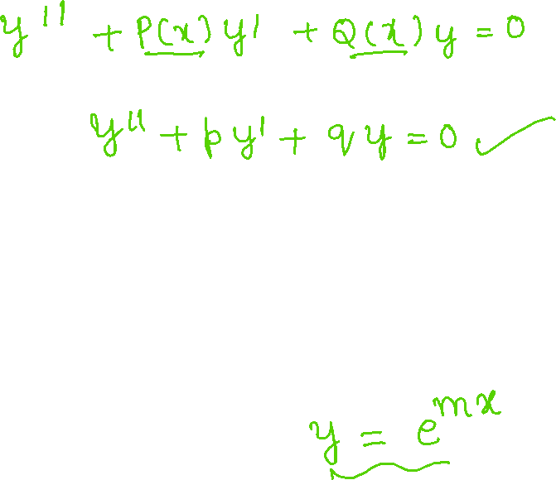
Section-17
The Homogenous Equation with constant coefficients

Slide 41
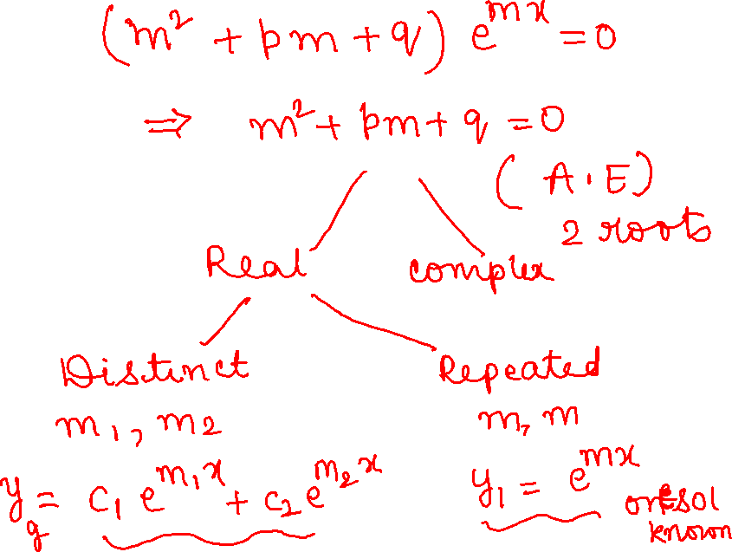

Slide 42
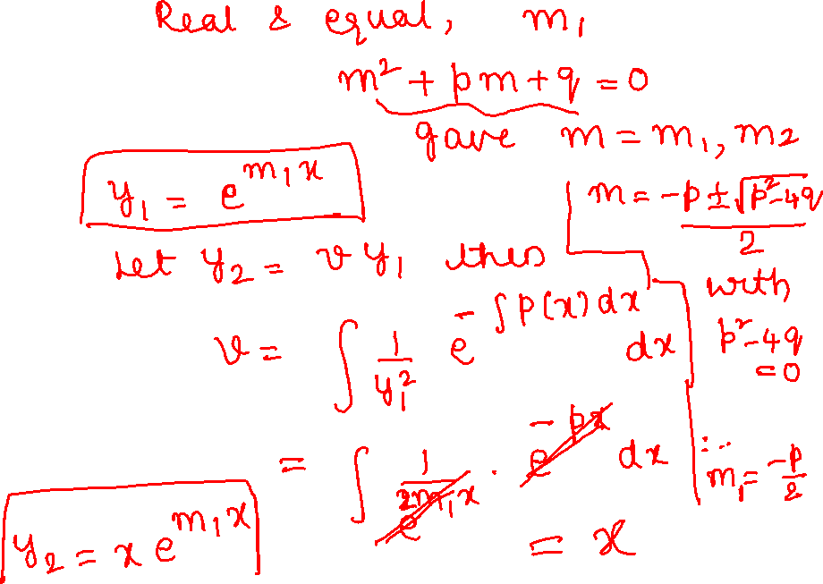

Slide 43
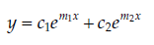
Section - 17
Now, we consider the three possibilities:
1.Distinct Real roots:
The roots m₁ and m₂ are real if and only if p²-4q > 0. Then, we get two solutions e^{m1x} and e^{m2x}
These solutions are linearly independent as their ratio is constant and hence, the general solution is

Slide 44
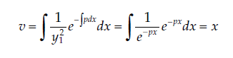
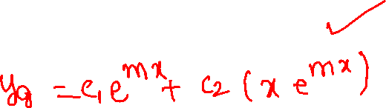
Section - 17
3.Equal real roots:
The roots m₁ and m₂ are equal if p²-4q = 0.
Here we obtain only one solution y = e^{mx} with m = -p/2.
The second solution is obtained by using the method in Section – 16 by taking

Slide 45
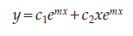
Section - 17
Which implies that y₂ = vy₁ = xe^{mx}
So, the general solution in this case is

Slide 46
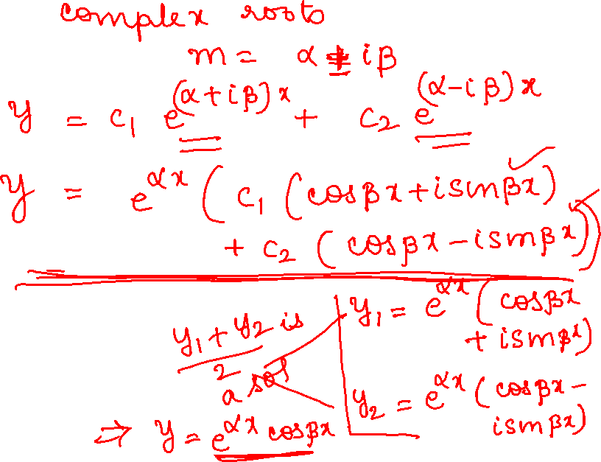

Slide 47
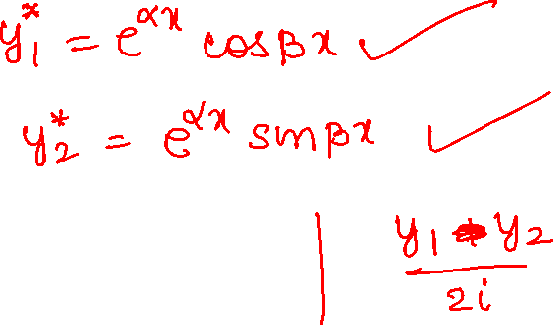

Slide 48
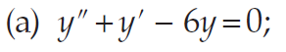
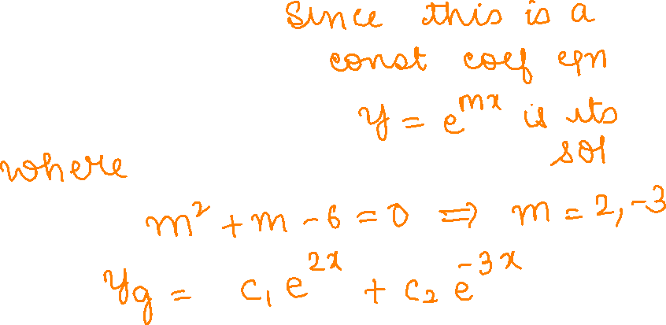
Section – 17

Slide 49
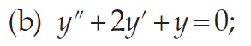
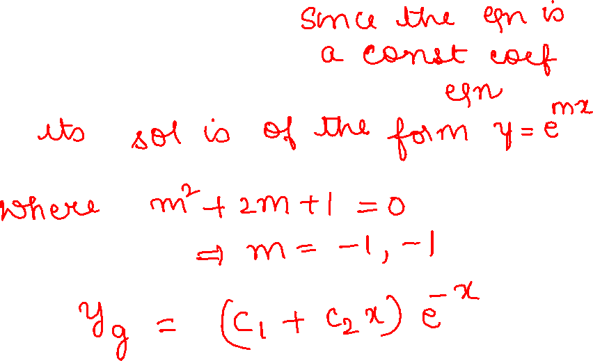

Slide 50
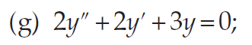
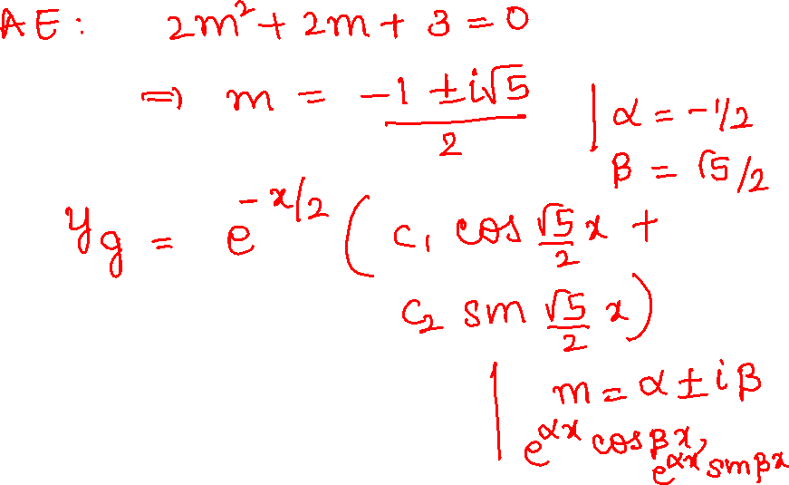

Slide 51
Lecture on 26/9/22

Slide 56
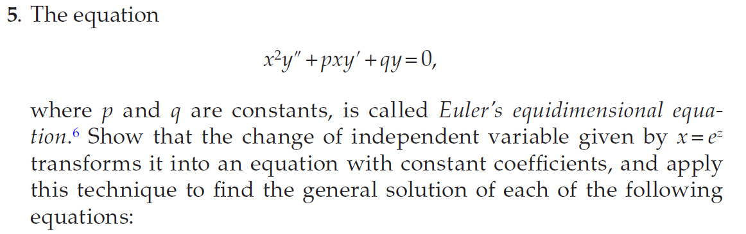
Section – 17

Slide 59
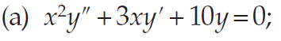

Slide 60
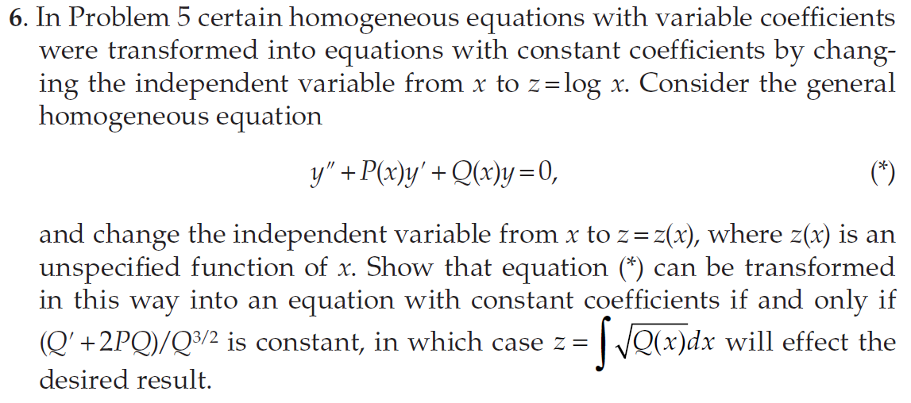
Section - 17

Slide 64


Section - 17

Slide 65
Section 18
The Method of Undetermined Coefficients

Slide 66
Section – 18 The Method Of Undetermined Coefficients
For the equation y”+P(x)y’+Q(x)y = R(X), if the general solution y_{g} (x) is known and if y_{p} (x) is any particular solution then the general solution is
y(x) = y_{g} (x) + y_{p} (x)

Slide 67
Section – 18 The Method Of Undetermined Coefficients
The Method of Undetermined Coefficients is a procedure for finding y_{p} when the equation y”+P(x)y’+Q(x)y = R(X) has the form y”+py’+qy= R(x),
where R(x) is an exponential, a sine or cosine, a polynomial, or some combination of such functions.

Slide 70

Section – 18

Slide 74


Slide 76


Section – 18

Slide 78
Section 19
The method of variation of parameters

Slide 79
Section – 19 The Method of Variation of Parameters
If we know the general solution of y”+P(x)y’+Q(x)y = 0, then we can find the general solution of y”+P(x)y’+Q(x)y = R(X).
We assume y = v₁(x) y₁ + v₂(x)y₂ will be the solution.

Slide 82

Section – 19 The Method of Variation of Parameters
v₁(x) and v₂(x) can be found by using the following equations:

Slide 83


Slide 86

Section – 19

Slide 89
Section – 22 Higher Order Linear Equations

Slide 90


Slide 92
Section 23
Operator Method for finding Particular Solution

Slide 93
Section – 23 Operator Method for Finding Particular Solutions

Slide 97


Slide 102




Problems..

Slide 103


Slide 104


Slide 105


Solve the following D.E

Slide 106


Slide 107


Slide 108


